Slide 1
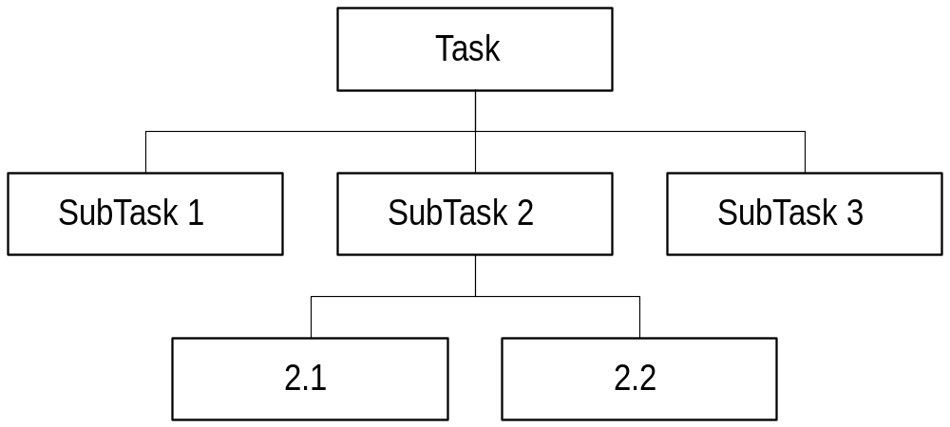
SubPrograms
Top-Down Design using stepwise refinement leads to division of tasks

Slide 2
Outline
III. Modular Programming
  A. Advantages
    readability, reusability, modularity, data security
  B. Declaration (prototype)
  C. Definition
  D. Call
  E. Parameters
    by value
    by reference
  F. Executing Functions

Slide 3
Outline (cont)
  G. Function Types
    no parameters
    value parameters
    reference parameters
    return type
  H. Scope
  I. Documentation
  J. Iterative Programming
  K. Standard Library Functions
    use of include
    abs,labs,fabs,floor,ceil,rint,pow,sqrt,rand,srand

Slide 4
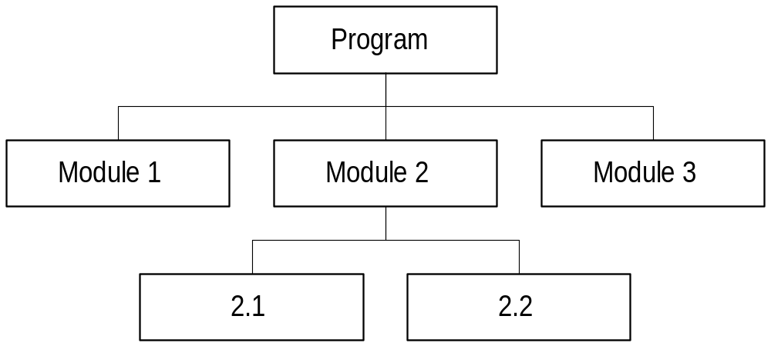
Modularity
Subtasks captured by Modules of program
Should be able to design, code, test each module independently

Slide 5
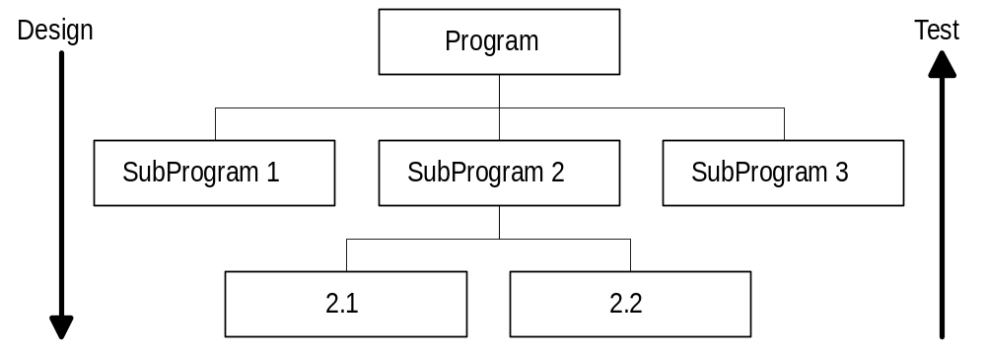
Structured Programming
Structured programs lend themselves to Bottom-Up Testing
Large programs can be written by teams

Slide 6
What is a Subprogram?
Program within a program
Own name and set of local declarations
In C, done with functions
Advantages
  reusability
  readability
  modularity (ease of implementation)
  protecting data

Slide 7
Unstructured Program
int main( void ) {
/* Get data from user */
statement1;
statement2;
statement3;
/* Perform computations */
statement4;
statement5;
statement6;
statement7;
/* Print results */
statement8;
statement9;
}

Slide 8
Corresponding Structured Program
int main( void ) {
GetData(parameters); /* procedure calls */
Compute(parameters);
Print(parameters);
}
Subprograms (functions) defined after main
Program more readable, function names give an idea of what is being done

Slide 9
Flow through Structured Program
GetData -- call --> statement1;
statement2;
statement3;
<- return -
Compute -- call --> statement4;
statement5;
statement6;
statement7;
<- return -
Print -- call --> statement8;
statement9;
<- return -

Slide 10
Reusability
Subprograms can be reused (no rewriting)
{
funcA(); /* Statements in A executed */
funcB(); /* Statements in B executed */
funcA(); /* A executed again */
}
But what if two versions of A differ slightly?
  (e.g., print 1st person data, 2nd person data)

Slide 11
Parameters
Parameters used to supply information to, and receive info from functions
  for example, pass print person function the data to be printed (once with data for first person, once with data for second person)
Types of parameter passing in C
  by value: value is calculated, then passed
  by reference: address is calculated, passed
  reference allows functions to change variables

Slide 12
Transmission of Data
Arrows used in structure chart to indicate if data received/sent by module
Module specifications describe data:
  Perform Computations
    Data received: starting balance, trans type and amount
    Info returned: ending balance
Update
Checkbook
Get
Data
Perform
Computations
Print
Results

Slide 13
Using Functions
Function declaration (prototype) - often separate from definition
Function definition - parameters and body of function
Function call(s) - one or more uses of a function (by calling it from another function, for example, main)

Slide 14
Function Prototype (Declaration)
Needed when function called before defined
Consists of the function header:
  ReturnType Name(ParameterList);
Header is repeated from definition (but with ; at end rather than body)
Prototype informs compiler function will be defined, what the parameters are and what is calculated

Slide 15
Function Definition
Syntax:
  ReturnType Name( Parameter_List ) /* Header */
  { /* Body */
  Local Declarations
  Statements
  }

Slide 16
Function Definition (cont)
Return type: value calculated by function
  If no value calculated, use void type
Name: identifier (must be unique), used when calling function
Formal Parameters: list of 1 or more parameter items separated by commas
  parameter item: Type Name
  list: Type Name, Type Name, Type Name, …
  if no parameters use void instead of list

Slide 17
Function Definition (cont)
Local declarations
  variables
  memory constants
  etc.
Statements
  sequence of statements executed in order (from start of body to end of body)
  may include Return statement

Slide 18
Return Statement
Syntax:
  return; /* If Return Type is void */
  return Expression; /* Return Type not void */
At least one must appear in function that has a non-void return type
Return indicates function should stop and return value indicated

Slide 19
Function Call
Syntax: Name(Argument_List)
Name indicates which function being called
Arguments give values for each parameter in the parameter list (separated by commas)
  syntax: Value, Value, Value, …
  one argument for each parameter
  parameters matched in order
  must be of same type as parameter
If function returns value, it may be included in expression, if void, may stand alone

Slide 20
Function Execution
Parameters evaluated:
  Each argument is evaluated to produce a value
  New local variable created for each parameter
  Arguments copied to new local variables
Body of function executed:
  Local declarations created (local variables, etc.)
  Each statement in body executed in order (until last statement or return statement encountered)
Function ends:
  local variables removed (freed)
  return value determined
  execution returns to after call

Slide 21
Execution Example
float tempConv(float f); /* Prototype */
int main ( void ) {
float ftemp = 77;
float ctemp;
ctemp = tempConv(ftemp); /* Call */
}
float tempConv(float f) { /* Header */
float cval; /* Local Decl */
cval = (f - 32) * 5 / 9; /* Statements */
return cval; /* Return */
}

Slide 22
Execution Example (cont)
Main function executed:
  variables declared (initialized)
  ftemp: 77 ctemp: ?
  tempConv called
    ftemp evaluated (77)
    local var f created
    value 77 is copied to f
    local var cval created
    assignment statement executed (25 stored in in cval)
    return executed - 25 sent as value calculated
  assignment evaluated - 25 stored in ctemp

Slide 23
Function Prototype
Return type must be the same in definition
Parameter list must have same number, same type and same order as list in def.
Parameter names do not have to match
In fact, parameter names can be left out entirely
Prototypes can be omitted in function used is defined first

Slide 24
Checkbook Program
Update
Checkbook
Compute
New
Balance
Get
Data
Print
Data
Explain

Slide 25
Checkbook Example
void Explain( void ); /* Prototypes */
void GetData( float *StartBal,
char *TransType, float *TransAmount );
float ComputeNewBal( float StartBal,
char TransType, float TransAmount );
void PrintData( float StartBal,
float EndBal, char TransType,
float TransAmount );
int main ( void ) {
float sbal; /* Local vars in main */
char ttype;
float tamount;
float ebal;

Slide 26
Checkbook Example
/* Function calls making up program */
Explain();
GetData(&sbal,&ttype,&tamount);
ebal = ComputeNewBal(sbal,ttype,tamount);
PrintData(sbal,ebal,ttype,tamount);
return 0;
}

Slide 27
Function without Parameters
void Explain( void ) {
printf("This is a checkbook program.”);
printf(“ I will prompt for a starting\n");
printf("balance and then a transaction”);
printf(“ to perform (a Withdrawl\n");
printf("or Deposit) and the amount of”);
printf(“ the transaction.\n");
printf("\n");
}

Slide 28
Function without Parameters (cont)
Called with an empty argument list
  example: Explain();
Same set of statements executed
  could still differ if the statements interact with the user
Could return a value (reading a number from user which is returned as value calculated)

Slide 29
Passing Data to Function
void PrintData( float StartBal,
float EndBal, char TransType,
float TransAmount ) {
printf("\n\n");
printf("Starting Balance $%6.2f\n”,
StartBal);
printf("Transaction $%6.2f %c\n",
TransAmount,TransType);
printf(" -------\n");
printf("Ending Balance $%6.2f\n",
EndBal);
}

Slide 30
Parameters Passed by Value
Arguments evaluated to produce values
Local variables are created for each formal parameter
Values are copied to new variables
Arguments and local variables are then separated (changing a local variable does not change the argument)

Slide 31
Calling PrintData
sbal
100.0
StartBal
ebal
75.0
EndBal
values copied
ttype
‘W’
TransType
tamount
25.0
TransAmount

Slide 32
Changing Local Variables
If local variable changed, does not affect argument
  example:
  EndBal = EndBal - 25.0;
  does not change ebal
When function ends, local variables are released

Slide 33
Parameter Passing Rules
Number of formal parameters/arguments much match
Types of formal parameters/arguments must match
Order of formal parameters/arguments must match
Types of parameters determined in function header

Slide 34
Arguments for Parameters
When passing parameters by value, any value of the correct type is ok
  example:
  PrintData(sbal,75.0,(char) 87,25.0 * 3);
The value of the argument is determined, and that value is then copied to the new local variable

Slide 35
Changing Non-local Variables
The scanf function actually changes the value of its arguments:
  example:
  scanf(“%f”,&Balance);
  changes the variable Balance
  but how?
The key is the &, the argument is being passed by reference (a value is passed, the location of the variable Balance in memory)

Slide 36
Passing by Reference
Argument passed is address of a variable
  in the call, an & is included before the variable address being passed
In function header, type of the variable is the type of the variable being passed by reference followed by *
Variable is the address of a location (to refer to the value at the address also use *)

Slide 37
Passing by Reference Example
void GetData( float *StartBal,
char *TransType, float *TransAmount ) {
printf("Please enter starting balance: ");
scanf("%f",StartBal);
fflush(stdin);
printf("What type of transaction (W for”);
printf(“ withdrawl or D for Deposit): ");
scanf(" %c",TransType);
printf("What is the amount of the “); printf(“transaction: ");
scanf("%f",TransAmount);

Slide 38
Passing by Reference Example
printf("\nYou have entered the following”);
printf(“ information:\n");
printf("Starting Balance: %1.2f\n",
*StartBal);
printf("Transaction Type: %c\n",*TransType);
printf("Transact. Amount: %1.f\n",
*TransAmount);
printf("\n");
}

Slide 39
Using Reference Variables
Name is the address of the argument
  Example: StartBal in GetData is the location of the argument
Can refer to the variable using the * form
  Example: *StartBal is the value of the variable StartBal is connected to

Slide 40
Calls with Reference Variables
GetData(&sbal,&ttype,&tamount);
sbal
100.0
StartBal
address of sbal
ttype
‘W’
TransType
address of ttype
Point to
tamount
25.0
TransAmount
address of tamount
Changing *StartBal changes sbal -- indirect addressing

Slide 41
Reference Arguments
Argument must be a variable with an & before the variable
  Example:
  GetData(&(sbal + 25.0),ttype,&75);
  Each argument is a problem (no address for each case)

Slide 42
Functions with Return Types
Functions that return/calculate single values can use the return type for that value
Type of the function indicates the value being calculated
Must be at least one return statement in function
Return statement indicates value calculated

Slide 43
Function with Return
float ComputeNewBal( float StartBal,
char TransType, float TransAmount ) {
float EndBal = StartBal;
if (TransType == 'W')
EndBal -= TransAmount;
else if (TransType == 'D')
EndBal += TransAmount;
return EndBal; /* value calculated */
}

Slide 44
Creating Functions
Choose a meaningful name
Data sent to function?
  Yes, one parameter for each data value
  No, void parameter list
Function calculates/changes one value?
  Yes, use appropriate return type
  No, void return type
Function calculates/changes >1 value?
  Yes, use reference parameters

Slide 45
Scope
Scope of identifier is part of program where the identifier can be referenced
Global scope - identifiers declared outside of any function, can be viewed anywhere in file
Local scope - identifiers declared inside a function are local to that function, also identifiers declared within blocks are local to that block

Slide 46
Scope Example
int x1;
float f1
(float x2) {
int x3;
{
char x4;
}
}
x1, f1 declared in outer scope
x2, x3 declared in inner scope
x4 declared inner, inner scope

Slide 47
Scope Rules
An identifier can only be used in a block in which it is declared
Declaration of identifier must occur before its first use
For two identifiers with the same name, the one with the smaller scope is the one in effect within its subblock

Slide 48
Using Same Identifier
int x; /* global x */
float f1( void ) {
float x; /* x within f1 */
{
char x; /* x in block within f1 */
x = ‘A’;
}
x = 5.0;
}
int main( void ) {
x = 3;
}

Slide 49
Programming Practices
Changing global variables within functions allowed but not encouraged
To change global variables pass them as reference parameters to functions
Since constants do not change, can be referenced anywhere
Using same name for different variables is a matter of style

Slide 50
Documenting Subprograms
Each function should have comment following header with:
  /* Given: summary of data received */
  /* Task: statement of task being performed */
  /* Return: statement of value(s) to be returned */
Specification should be written during algorithm design

Slide 51
Developing Modular Programs
Develop one module at a time
  not necessarily first to last
Test modules independently using driver program
  driver has call(s) to test modules
  calls to other modules left or commented out
  completely test before working on next module
Iterative programming

Slide 52
Iterative Programming
Create main function with function calls
Comment out calls to functions not written
As functions defined, add calls
main of checkbook program:
Explain(); /* test Explain() alone */
/* GetData(&sbal,&ttype,&tamount);
ebal = ComputeNewBal(sbal,ttype,tamount);
PrintData(sbal,ebal,ttype,tamount); */

Slide 53
Iterative Programming (cont)
Can test even if earlier routines not implemented
Test Print Data by passing test values rather than variables:
Explain(); /* test Explain() alone */
/* GetData(&sbal,&ttype,&tamount);
ebal = ComputeNewBal(sbal,ttype,tamount);
*/
PrintData(100.0,125.0,’D’,25.0);

Slide 54
Standard Library Functions
C provides libraries that contain lots of functions of interest
  stdio.h - standard input/output routines
  stdlib.h - other useful functions
  math.h - math functions
To use these functions we include the header file of the library (ending in .h)
  header file contains prototypes of functions
  definitions are compiled elsewhere, connected to your program when the program is linked

Slide 55
Using Library Functions
Add #include with name of desired library
  example: #include <math.h>
May need to inform linker that library should be added to program
  using gcc or cc on unix:
  gcc filename.c -lm
How this is done depends on compiler

Slide 56
Absolute Value Functions
From <stdlib.h>
Prototypes:
  int abs( int number )
  long labs( long number )
  double fabs( double number )
Return absolute value of number
  abs(-5) is 5

Slide 57
Rounding Numbers
From <math.h>
  double ceil( double number )
  round number up to next whole number
  ex. ceil(4.2) is 5.0
  double floor( double number )
  round number down to next whole number
  ex. floor(4.8) is 4.0
  double rint( double number )
  round number to nearest whole number
  ex. rint(4.6) is 5.0

Slide 58
Other Math Functions
double pow( double x, double y )
returns x raised to the exponent y
pow(2.0,3.0) returns 8.0
double sqrt( double number )
returns sqrt of number
sqrt(16.0) returns 4.0

Slide 59
Random Numbers
From <stdlib.h>
  int rand( void )
    generates mathematically a “random” integer
    note the same sequence is generated each time unless you use srand
  void srand( unsigned int seed )
    sets the initial “seed” when generating random sequence (different seed - different sequence)
    standard use:
    srand( time ( NULL ) ); /* include time.h */
    sets seed based on clock time

